Slide 1
Database Design
Normalization
Zhihua Du
College of Computer Science and Software Engineering Shenzhen University

Slide 2
What you learn:
Problems related to DB design (Anomalies) (不规则)
How to overcome (Normal Form)
How does it relate to last class( Functional Dependency and Relational DB theory )

Slide 3

Content of this Class:
Normalization concept and the process
First normal form (the foundation!)
  Identify Multi values VS Nested relationship
  Decomposing table
  Finding primary keys
  Set up a foundation for other Normal form

Slide 4
Normalisation
Defn: Normalisation : is a technique for producing a set of relations with desirable properties, given the data requirements of an enterprise.

Slide 5
Data Normalization
Primarily a tool to validate and improve a logical design so that it satisfies certain constraints that avoid unnecessary duplication of data
The process of decomposing relations with anomalies to produce smaller, well-structured relations

Slide 6
What is Well-Structured Relations?
Def: A relation that contains minimal data redundancy and allows users to insert, delete, and update rows without causing data inconsistencies is called Well-Structured Relations.
Goal is to avoid anomalies such as:
  Insertion Anomaly – adding new rows forces user to create duplicate data
  Deletion Anomaly – deleting rows may cause a loss of data that would be needed for other future rows
  Modification Anomaly – changing data in a row forces changes to other rows because of duplication
General rule of thumb: a table should not pertain to more than one entity type

Slide 7

Example – Employee2
Question – Is this a relation?
Answer – Yes: unique rows and no multivalued attributes
Question – What’s the primary key?
Answer – Composite: Emp_ID, Course_Title

Slide 8
Anomalies (不规则) in this Table
Insertion – can’t enter a new employee without having the employee take a class
Deletion – if we remove employee 140, we lose information about the existence of a Tax Account class
Modification – giving a salary increase to employee 100 forces us to update multiple records

Slide 9
Cont…
Why do these anomalies exist?
Because we’ve combined two themes (entity types) into one relation.
This results in duplication, and an unnecessary dependency between the entities

Slide 10
Functional Dependencies and Keys
Functional Dependency: The value of one attribute (the determinant) determines the value of another attribute
Candidate Key:
  A unique identifier. One of the candidate keys will become the primary key
    E.g. perhaps there is both credit card number and SS# in a table…in this case both are candidate keys
  Each non-key field is functionally dependent on every candidate key

Slide 11
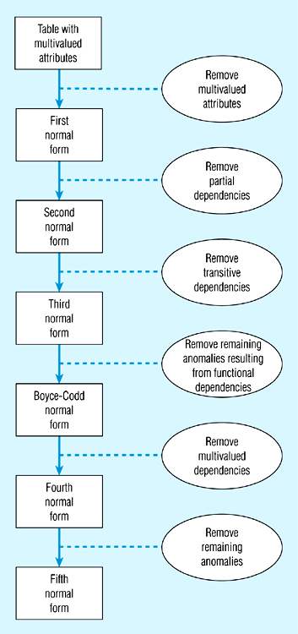
Steps in normalization

Slide 12
First Normal Form
No multivalued attributes
Every attribute value is atomic
Employee2 table is in 1st Normal form

Slide 13
Examine the following table
Sid | Sname | Phone | Course-id | Course-description | Credit-hours | Grade
100 | John | 487 2454 | IS380 | Database Concepts | 3 | A
100 | John | 487 2454 | IS416 | Unix Operating System | 3 | B
200 | Smith | 671 8120 | IS380 | Database Concepts | 3 | B
200 | Smith | 671 8120 | IS416 | Unix Operating System | 3 | B
200 | Smith | 671 8120 | IS420 | Data Net Work | 3 | C
300 | Russell | 871 2356 | IS417 | System Analysis | 3 | A

Slide 14
Primary Key
Examination of the above Student-courses relation reveals that Sid does not uniquely identify a row (tuple) in the relation hence cannot be the primary key.
For the same reason Course-id cannot be the primary key.
However the combination of Sid and Course-id uniquely identifies a row in Student-courses, Therefore (Sid, Course-id) is the primary key of the above relation.

Slide 15
Cont…
The primary key determines every attribute.
For example if you know both Sid and Course-id for any student you will be able to retrieve Sname, Phone, Course-description, Credit-hours and Grade, because these attributes are dependent on the primary key.

Slide 16
Second Normal Form
1NF plus every non-key attribute is fully functionally dependent on the ENTIRE primary key
  Every non-key attribute must be defined by the entire key, not by only part of the key
  No partial functional dependencies
  Therefore the student-course table is not in 2NF

Slide 17
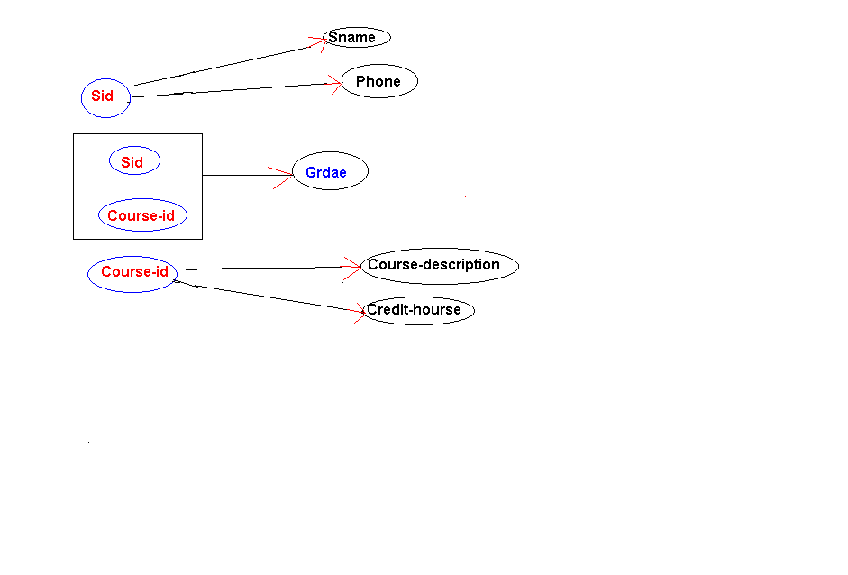

Figure below is the graphical representation of the functional dependency between the primary key and attributes of the above relation.

Slide 18
2NF
To convert Student-courses to second normal relations we have to make all non-primary attributes to be fully functionally dependent on the primary key.
To do that we need to decompose (that is we break it down to two or more relations)
Student-courses table into two or more tables.
However decomposition may cause problems.
To avoid such problems it is important to keep attributes, which are dependent on each other in the same table
From dependency diagram we see that we should divide Student-courses relation into following three relations:

Slide 19
Student (Sid:pk, Sname, Phone)
Sid | Sname | Phone
100 | John | 487 2454
200 | Smith | 671 8120
300 | Russell | 871 2356
Courses (Course-id::pk, Course-Description)
Course-id | Course-description | Credit-hours
IS380 | Database Concepts | 3
IS416 | Unix Operating System | 3
IS420 | Data Net Work | 3
IS417 | System Analysis | 3

Slide 20
Student-grade (Sid:pk1:fk:Student, Course-id::pk2:fk:Courses, Grade)
Sid | Course-id | Grade
100 | IS380 | A
100 | IS416 | B
200 | IS380 | B
200 | IS416 | B
200 | IS420 | C
300 | IS417 | A

Slide 21
Free From Anomalies
Further these three sets are free from all anomalies. Let us clarify this in more detail.
Insertion anomaly: Now a new Course with course-id IS247 and Course-description can be inserted to the table Course.
Equally we can add any new students to the database by adding their id, name and phone to Student table.
Therefore our database, which made up of these three tables does not suffer from insertion anomaly.
Update anomaly: Since redundancy of the data was eliminated no update anomaly can occur. To change the course-description for IS380 only one change is needed in table Courses.
Deletion anomaly: the deletion of student Russell from the database is achieved by deleting Russell's records from both Student and Student-grade relations and this does not have any side effect because the course IS417 untouched in the table Courses.

Slide 22
Functional Dependencies in EMPLOYEE2
Dependency on entire primary key
EmpID
CourseTitle
Name
DeptName
Salary
DateCompleted
Dependency on only part of the key (Partial Dependency)
EmpID, CourseTitle ➔ DateCompleted
EmpID ➔ Name, DeptName, Salary
Therefore, NOT in 2nd Normal Form!!

Slide 23
Getting it into 2nd Normal Form
Decompose into two separate relations
Both the table are now full functionally dependent on primary key
EmpID
Name
DeptName
Salary
EmpID
CourseTitle
DateCompleted

Slide 24
Third Normal Form
2NF PLUS no transitive dependencies (one attribute functionally determines a second, which functionally determines a third)
no transitive dependencies: key attribute X, attribute z, non-key attribute Z, X →Y，Y→Z (Y → X，Z ⊆ Y）

Slide 25
Consider the STUDENT ACTIVITY table shown below (Sid: pk, Activity, fee)
Sid | Activity | Fee
100 | Swimming | 100
200 | Tennis | 100
300 | Golf | 300
400 | Swimming | 100
Student ID (SID)----------→Activity I,e SID determine Activity
Further Activity ------------> fee that is the Activity determine the fee

Slide 26
3NF
Table STUDENT is in first normal form because all its attributes are simple.
Also STUDENT is in second normal form because all its non-primary attributes are fully functionally dependent on the primary key (Sid).
Notice that a first normal relation with non-composite (that is simple) primary key automatically will be in second normal form because all its non-primary attributes will be fully functionally dependent on the primary key.

Slide 27
3NF
Table STUDENT suffers from all 3 anomalies;
No activity can be inserted into the database unless we get a student to take that activity.
There is redundancy in the table (see Swimming), therefore to change the fee for Swimming we must make changes in more than one place and that will cause update anomaly problem.
If student 300 is deleted from the table we also loose the fact that we had Golf activity with its fee to be 300.
To overcome these anomalies STUDENT table should be decomposed into smaller tables.

Slide 28
STUD-AVT (Sid:pk, Activity) with the following data :
STUD_ACT
Sid | Activity
100 | Swimming
200 | Tennis
300 | Golf
400 | Swimming
AVT-Fee (Activity:pk, Fee)
AVT-Fee
Activity | Fee
Swimming | 100
Tennis | 100
Golf | 300
Swimming | 100

Slide 29
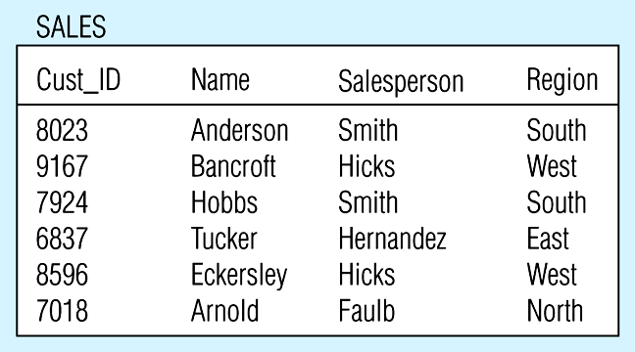
Relation with transitive dependency
(a) SALES relation with simple data

Slide 30
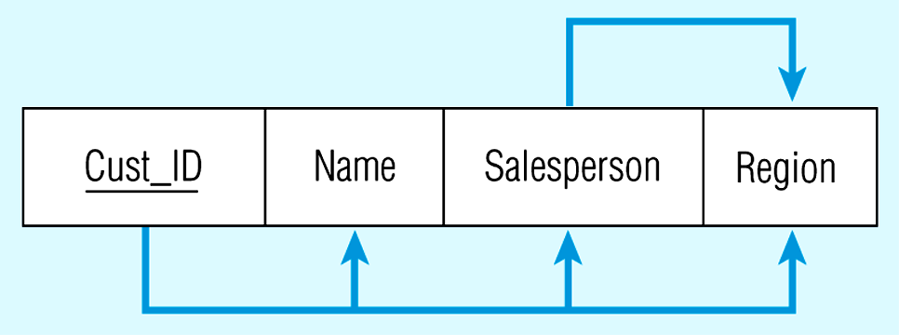
Below Figure shows Relation with transitive dependency
CustID → Name
CustID → Salesperson
CustID → Region
All this is OK
(2nd NF)
BUT
CustID → Salesperson → Region
Transitive dependency
(not 3rd NF)

Slide 31
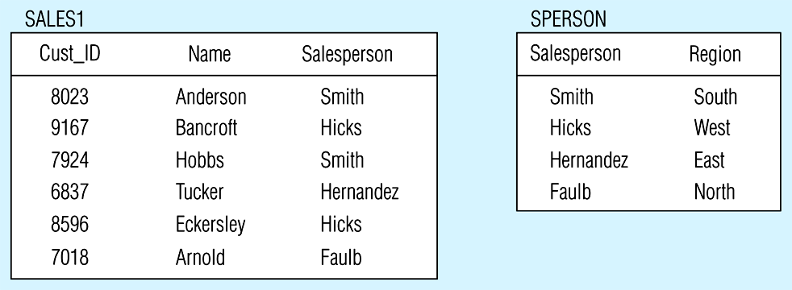
Removing a transitive dependency
(a) Decomposing the SALES relation

Slide 32
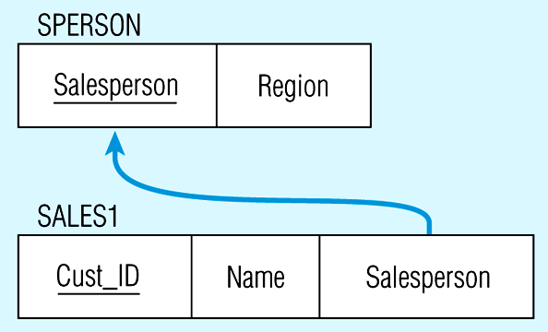
Relations in 3NF
Salesperson → Region
CustID → Name
CustID → Salesperson
Now, there are no transitive dependencies…
Both relations are in 3rd NF

Slide 33
Summary: 2NF
A relation is in 2NF if it contains no repeating groups and no partial key functional dependencies exists
Rule: A relation which is in 1NF having a single key field is said to be in 2NF
To convert a relation with partial functional dependencies to 2NF. create a set of new relations:
One relation for the attributes that are fully dependent upon the key.
One relation for each part of the key that has partially dependent attributes

Slide 34
Summary: 3NF
A relation is in 3NF if it contains no repeating groups, no partial functional dependencies, and no transitive functional dependencies
To convert a relation with transitive functional dependencies to 3NF, remove the attributes involved in the transitive dependency and put them in a new relation
Rule: A relation in 2NF with only one non-key attribute must be in 3NF
In a normalized relation a non-key field must provide a fact about the key, the whole key and nothing but the key.
Relations in 3NF are sufficient for most practical database design problems.
However, 3NF does not guarantee that all anomalies have been removed.

Slide 35
Other Normal Forms
Boyce-Codd NF
  All determinants are superkeys…there is no determinant that is not a unique identifier
4th NF
  No multivalued dependencies
5th NF
  No “lossless joins”

Slide 36
Boyce-Codd Normal Form (BCNF)
When a relation has more than one candidate key, anomalies may result even though the relation is in 3NF
3NF does not deal satisfactorily with the case of a relation with overlapping candidate keys
i.e. composite candidate keys with at least one attribute in common.
BCNF is based on the concept of a determinant.
A determinant is any attribute (simple or composite) on which some other attribute is fully functionally dependent.
A relation is in BCNF if, and only if, every determinant is a superkey.

Slide 37
BCNF
Consider the following relation and determinants.
Let R(a,b,c,d) be a relation
a,c -> b,d
a,d -> b
candidate keys are: {a,c},{a,d},{a,b}
Thus this relation is in BCNF

Slide 38
Boyce-Codd Normal Form
Defn: A relation is in BCNF if every determinant is a superkey.

Slide 39
BCNF applies to a relation which has more than one candidate key, and the candidate keys are composite and overlapping.
Consider the following relation
SSL(student, subject, lecturer)

Slide 40
SSL(student, subject, lecturer)
Assume that: each teacher teach only one subject. A subject has several teachers to teach,
{student, subject} → lecturer;
lecturer → subject
Is it in bcnf?
STUDENT | SUBJECT | LECTURER
123 | PHYSICS | EINSTEIN
123 | MUSIC | MOZART
456 | BIOLOGY | DARWIN
789 | PHYSICS | BOHR
999 | PHYSICS | EINSTEIN

Slide 41
ANOMILY (不规则)
If the record for student 456 is deleted we lose not only information on student 456 but also the fact that DARWIN Lecture’s in BIOLOGY
we cannot record the fact that WATSON can Lecture on COMPUTING until we have a student who take a subject in COMPUTING to whom we can assign WATSON as an Lecturer.

Slide 42
Convert to BCNF
STUDENT,SUBJECT,LECTURER
BREAK DOWN INTO TWO TABLES
Lecture → Subject (X→ Y) (FIRST TABLE)
REMOVE Y
STUDENT, LECTURER (SECOND TABLE)

Slide 43
Convert to BCNF we have two tables:
LECTURER | SUBJECT
EINSTEIN | PHYSICS
MOZART | MUSIC
DARWIN | BIOLOGY
BOHR | PHYSICS
STUDENT | LECTURER
123 | EINSTEIN
123 | MOZART
456 | DARWIN
789 | BOHR
999 | EINSTEIN

Slide 44
Another Example:
Supplier(supplierNo, productCode, supplierName, quantity)
Where supplierNo ←→SupplierName
Is it in 1NF?
Is it in 2NF?
Is it in 3NF?
Is it in BCNF?

Slide 45
supplierNo
productCode
quantity
supplierNo
supplierName
OR
supplierName
productCode
quantity
supplierName
supplierNo

Slide 46
EXAMPLES
[EX1] C（Cno，Cname，Pcno）
  C∈3NF
  C∈BCNF
[EX2] S（Sno，Sname，Sdept，Sage）
  Suppose the relation s has two keys:Sno，Sname
  S∈3NF。
  S ∈ BCNF
An Introduction to Database System

Slide 47
CON…
［EX3］SJP（S，J，P）
    FD：（S，J）→P；(J，P）→S
    （S，J）AND（J，P）are candidate keys
    SJP∈3NF，
    SJP∈BCNF
An Introduction to Database System

Slide 48
CON…
[EX4]In STJ（S，T，J），S are students，T are teachers，J are lessons。
  FD：
(S，J)→T，(S，T)→J，T→J
  (S，J) and (S，T) are candidate keys.
An Introduction to Database System

Slide 49
CON…
S
S
T
J
J
T
An Introduction to Database System

Slide 50
CON…
STJ∈3NF
STJ∈BCNF
An Introduction to Database System

Slide 51
CON…
Solution：
ST(S，T) ∈ BCNF， TJ(T，J)∈ BCNF
  There is NOT any attribute PARTIAL and TRANSITIVELY FUNTIONALLY dependent on any key
S
T
T
J
ST
TJ
An Introduction to Database System

Slide 52
Question
R<U,F>
U={A,B,C,D,E,F,G}
F={B->E,A->G,CD->F}
ABCD is the key
Question：R belongs to which Norm form？
An Introduction to Database System

Slide 53
Normal Forms: Summary (1)
3NF removes all insertion anomalies and deletion anomalies, as well as most redundancies.
BCNF achieves all achieved by 3NF. In addition, BCNF removes all redundancies caused by FDs.

Slide 54
Normalization (1)
A relation schema is in good quality if it is in BCNF.
If a relation schema is not in BCNF, then decompose it into a set of schemas such that
every new schema is in BCNF;
it is a lossless-join decomposition;
it is a dependency-preserving decomposition.

Slide 55
Normalization (2)
Problem: There is no guarantee that such an ideal decomposition exists.
can guarantee: lossless-join decomposition into BCNF.
can't guarantee: dependency-preserving decomposition into BCNF.
For a given relation schema R, if there is no lossless-join and dependency-preserving decomposition into BCNF, be happy if R is in 3NF.

Slide 56
Normalization (3)
If R is not even in 3NF, decompose it into a set of schemas such that
every new schema is in 3NF;
it is a lossless-join decomposition;
it is a dependency-preserving decomposition.
Such a decomposition can always be found!

Slide 57
Normalization to BCNF (1)
Algorithm LLJD-BCNF
Input: A relation schema R, a set of FDs in R.
Output: A lossless-join decomposition D such that each new schema in D is in BCNF.

Slide 58
Normalization to BCNF (2)
D := {R};
while ∃ R_{i} ∈ D that is not in BCNF do {
find an FD X Y such that
(1) X Y makes R_{i} not in BCNF, and
(2) XY ⊆ R_{i};
replace R_{i} by (R_{i} – Y) and XY in D;
}

Slide 59
Normalization to BCNF (3)
Theorem 5: Algorithm LLJD-BCNF is correct.
Every schema in D is in BCNF because the algorithm will not stop if there is a schema in D that is not in BCNF.
D is a lossless-join decomposition because in each iteration R_{i} is decomposed into 2 smaller schemas (R_{i} – Y) and XY and they satisfy the condition:
(R_{i} – Y) ∩ XY = X (XY – (R_{i} – Y)) = Y.

Slide 60
Normalization to BCNF (4)
Example: Prod_Manu(Prod_no, Prod_name, Price, Manu_id, Manu_name, Address),
F = {Mi Mn A, P# Pn Mi}.
Note that Price is not involved in any functional dependency.
Candidate keys: P# Pr
Initialization: D = {P# Pn Pr Mi Mn A}

Slide 61
Normalization to BCNF (5)
1st iteration: R_{i} = {P# Pn Pr Mi Mn A} is not in BCNF because Mi Mn A is not a trivial FD and Mi is not a superkey.
Replace R_{i} by Mi Mn A and P# Pn Pr Mi.
Hence: D = {Mi Mn A, P# Pn Pr Mi}.
Mi Mn A is in BCNF because in Mi Mn A, Mi is a candidate key.
How about P# Pn Pr Mi? Is it in BCNF?

Slide 62
Normalization to BCNF (6)
2nd iteration: R_{i} = P# Pn Pr Mi is not in BCNF because P# Pn Mi is not a trivial FD and P# is not a superkey in P# Pn Pr Mi.
Replace P# Pn Pr Mi by P# Pn Mi and P# Pr.
Hence, D = {Mi Mn A, P# Pn Mi, P# Pr}.
P# Pn Mi is in BCNF because in P# Pn Mi, P# is a candidate key.
P# Pr is in BCNF (see theorem on next page).
Final result: D = {Mi Mn A, P# Pn Mi, P# Pr}.
Question: Is D dependency-preserving?
Answer: Yes.

Slide 63
Normalization to BCNF (7)
Theorem 6: Any relation schema with exactly two attributes is in BCNF.
The proof is not difficult.
Note: The LLJD-BCNF algorithm may produce different decompositions depending on the order in which FDs are considered. Not all decompositions make sense.
Example: Suppose for the earlier example, we apply P# Pn Mi first. The final decomposition would be D = {P# Pn Mi, P# Mn A, P# Pr}. This decomposition separates Mi and Mn A in different schemas.

Slide 64
Minimal Cover (1)
Definition: Let F be a set of FDs. Fmin is a minimal cover of F if
Fmin is a cover of F.
Every FD in Fmin has a single attribute on the right.
No FD in Fmin is redundant. (X Y∈F is redundant if F – {X Y} ≡ F).
For any X Y ∈ Fmin, no attribute in X is extraneous (A ∈ X is extraneous if (X – {A}) Y can replace X Y).

Slide 65
Minimal Cover (2)
Example: Given F = {A BC, B C,
A B, AB C}, find Fmin.
F ≡ { A B, A C, B C, A B,
AB C }
≡ { A B, B C, AB C }
≡ { A B, B C } = Fmin

Slide 66
Minimal Cover (3)
Example: Let F = {A AC, B ABC,
D ABC}. Find Fmin.
F ≡ {A A, A C, B A, B B,
B C, D A, D B, D C}
≡ {A C, B A, B C, D A,
D B, D C}
≡ {A C, B A, D B} = Fmin

Slide 67
Minimal Cover (4)
Find Minimal cover three steps:
(1) Every FD in Fmin has a single attribute on the right
For X→Y∈F,
If Y=A₁A₂…A_{k} (k≥2),
then：
F ← (F - { X→Y } )∪{X→ A_{i} | i=1,2,…,k } 。
(2) No FD in Fmin is redundant
For X→A∈F,
Let G=F - {X→A},
If A∈X_{G}＋,
Then F ←G。
(3) no attribute in X is extraneous
For X→A∈F,
Let X=B₁B₂…B_{m} (m≥2),
Check B_{i} (i=1..m):
If A∈(X- B_{i})_{F}＋,
Then set F ← (F - { X→A } )∪{(X- B_{i})→A}。

Slide 68
Minimal Cover (5)
Example: Find F={ AC→A, C→B, B→A, C→D, C→A, AC→D, CB→BE }Minimal Cover
(1) Keep a single attribute on the right
F={ AC→A, C→B, B→A, C→D, C→A, AC→D, CB→B, CB→E }
(2) Remove redundant functional dependency
G={ C→B, B→A, C→D, C→A, AC→D, CB→B, CB→E }
(AC)_{G}⁺={ A,C,…}，
∵A∈(AC)_{G}＋ ，
∴set F ←G 。

Slide 69
Minimal Cover (5)
Example: Find F={ AC→A, C→B, B→A, C→D, C→A, AC→D, CB→BE }Minimal Cover
(1) Keep a single attribute on the right
F={ C→B, B→A, C→D, C→A, AC→D, CB→B, CB→E }
(2) Remove redundant functional dependency
G={ B→A, C→D, C→A, AC→D, CB→B, CB→E }
C_{G}⁺={ }，
C
, D
, A
∵B∈C_{G}＋ ，
∴F No change 。

Slide 70
Minimal Cover (5)
Example: Find F={ AC→A, C→B, B→A, C→D, C→A, AC→D, CB→BE }Minimal Cover
(1) Keep a single attribute on the right。
F={ C→B, B→A, C→D, C→A, AC→D, CB→B, CB→E }
(2) Remove redundant functional dependency
G={ C→B, C→D, C→A, AC→D, CB→B, CB→E }
B_{G}⁺={ B }，
∵A∈B_{G}＋ ，
∴F No change

Slide 71
Minimal Cover (5)
Example: Find F={ AC→A, C→B, B→A, C→D, C→A, AC→D, CB→BE }Minimal Cover
(1) Keep a single attribute on the right。
F={ C→B, B→A, C→D, C→A, AC→D, CB→B, CB→E }
(2) Remove redundant functional dependency
G={ C→B, B→A, C→A, AC→D, CB→B, CB→E }
C_{G}⁺={ }，
C
, B
, A
, D
, E
∵D∈C_{G}＋ ，
∴set F ←G 。

Slide 72
Minimal Cover (5)
Example: Find F={ AC→A, C→B, B→A, C→D, C→A, AC→D, CB→BE }Minimal Cover
(1) Keep a single attribute on the right。
F={ C→B, B→A, C→A, AC→D, CB→B, CB→E }
(2) Remove redundant functional dependency
G={ C→B, B→A, AC→D, CB→B, CB→E }
C_{G}⁺={ }，
C
, B
, A
, D
, E
∵A∈C_{G}＋ ，
∴set F ←G 。

Slide 73
Minimal Cover (5)
Example: Find F={ AC→A, C→B, B→A, C→D, C→A, AC→D, CB→BE }Minimal Cover
(1) Keep a single attribute on the right。
F={ C→B, B→A, AC→D, CB→B, CB→E }
(2) Remove redundant functional dependency
G={ C→B, B→A, CB→B, CB→E }
(AC)_{G}⁺={ }，
A, C
, B
, E
∵D∈ (AC)_{G}⁺ ，
∴F No change

Slide 74
Minimal Cover (5)
Example: Find F={ AC→A, C→B, B→A, C→D, C→A, AC→D, CB→BE }Minimal Cover
(1) Keep a single attribute on the right。
F={ C→B, B→A, AC→D, CB→B, CB→E }
(2) Remove redundant functional dependency
G={ C→B, B→A, AC→D, CB→E }
(CB)_{G}⁺={ }，
C, B,…
∵B∈(CB)_{G}⁺，
∴set F ←G 。

Slide 75
Minimal Cover (5)
Example: Find F={ AC→A, C→B, B→A, C→D, C→A, AC→D, CB→BE }Minimal Cover
(1) Keep a single attribute on the right。
F={ C→B, B→A, AC→D, CB→E }
(2) Remove redundant functional dependency
G={ C→B, B→A, AC→D }
(CB)_{G}⁺={ }，
C, B
, A
, D
∵E∈(CB)_{G}⁺，
∴F No change

Slide 76
Minimal Cover (5)
Example: Find F={ AC→A, C→B, B→A, C→D, C→A, AC→D, CB→BE }Minimal Cover
(1) Keep a single attribute on the right。
F={ C→B, B→A, AC→D, CB→E }
(2) Remove redundant functional dependency。
F={ C→B, B→A, AC→D, CB→E }
C→D,
(3) no attribute in X is extraneous
C_{F}⁺={ }，
C
, B
, A
, D
, E
∵D∈C_{F}⁺，
∴A is extraneous Remove

Slide 77
Minimal Cover (5)
Example: Find F={ AC→A, C→B, B→A, C→D, C→A, AC→D, CB→BE }Minimal Cover
(1) Keep a single attribute on the right。
F={ C→B, B→A, AC→D, CB→E }
(2) Remove redundant functional dependency
C→D,
F={ C→B, B→A, AC→ CB→E }
(3) no attribute in X is extraneous
B_{F}⁺={ }，
B
, A
∵E∈B_{F}⁺，
∴C Not extraneous, keep

Slide 78
Minimal Cover (5)
Example: Find F={ AC→A, C→B, B→A, C→D, C→A, AC→D, CB→BE }Minimal Cover
(1) Keep a single attribute on the right。
F={ C→B, B→A, AC→D, CB→E }
(2) Remove redundant functional dependency
F={ C→B, B→A, AC→ CB→E }
C→D,
C→E
(3) no attribute in X is extraneous
C_{F}⁺={ }，
C
, B
, A
, D
, E
∵E∈C_{F}⁺，
∴B is extraneous, Remove
Fmin：F_{m}={ C→B, B→A, C→D, C→E }

Slide 79
Normalization to 3NF (1)
Algorithm LLJD-DPD-3NF
Input: A relation schema R, a set of FDs F in R.
Output: A lossless-join and dependency-preserving decomposition D such that each schema in D is in 3NF.

Slide 80
Normalization to 3NF (2)
(1) Find all candidate keys.
(2) Compute Fmin.
(3) Let X A_{i}, i=1,...,m, be all FDs in Fmin that have the same left hand side X. Create a relation schema X∪ A₁ ∪ . . . ∪ A_{m} in D if it is not a subschema of an existing relation schema.
(4) If none of the relation schemas contain a candidate key of R, use a candidate key to form another relation schema.

Slide 81
Normalization to 3NF (3)
Example: Given
R(Instructor, Class_no, Classroom, Text),
F = {Class_no Classroom,Text}.
Candidate keys: Instructor Class_no.
Fmin = {Class_no Classroom,
Class_no Text}.
D = {Class_no Classroom Text,
Instructor Class_no}

Slide 82
Normalization to 3NF (4)
Example: R = CTHRSG, F = {C T, CS G, HR C, HS R, HT R }
Candidate keys: HS.
Fmin = F,
D = {CT, CSG, HRC, HSR, HTR}
HSR contains the candidate key.

Slide 83
Normalization Summary (1)
Given: R – A relation schema
F – A set of FDs in R
Find all candidate keys C of R using F
R, F, C
Is R in BCNF?
yes
done
no

Slide 84
Apply Algorithm LLJD-BCNF to
obtain a decomposition in BCNF
Is the decomposition
dependency-preserving?
yes
done
no
Roll back the decomposition

Slide 85
yes
Is R in 3NF?
done
no
Apply Algorithm LLJD-DPD-3NF
to obtain a decomposition in 3NF
done

Slide 86
4NF
based on another semantic concept (not FDs)
(i.e. capturing different semantic aspects (constraints) of the real life system)

Slide 87
Motivation - 4NF
courses - tutors - reference books
assumptions
    for a course - any number of tutors and any numbers of books
    a book can be used for any number of courses
    a tutor can teach any number of courses
    no link between tutors and books (!!!)

Slide 88
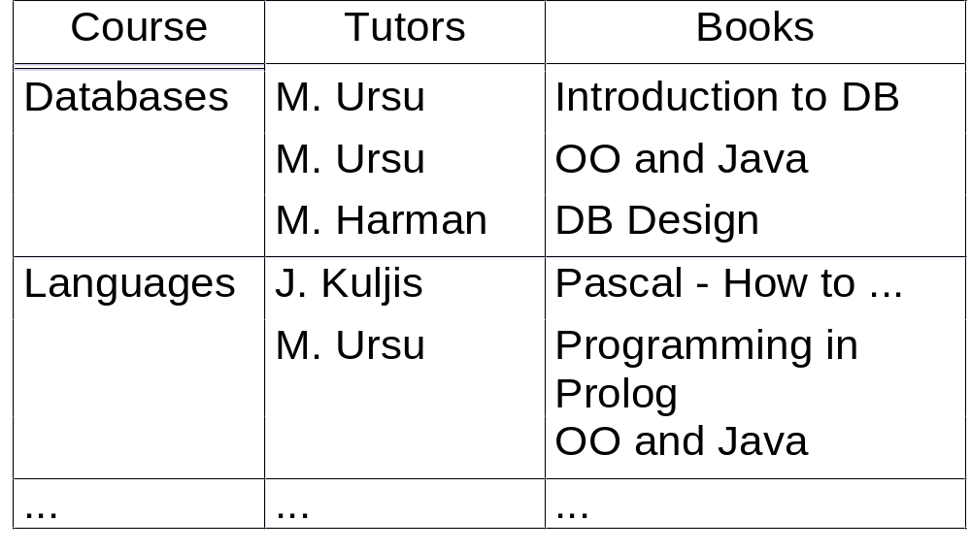
Un-normalised relation (CTB)
CTB

Slide 89
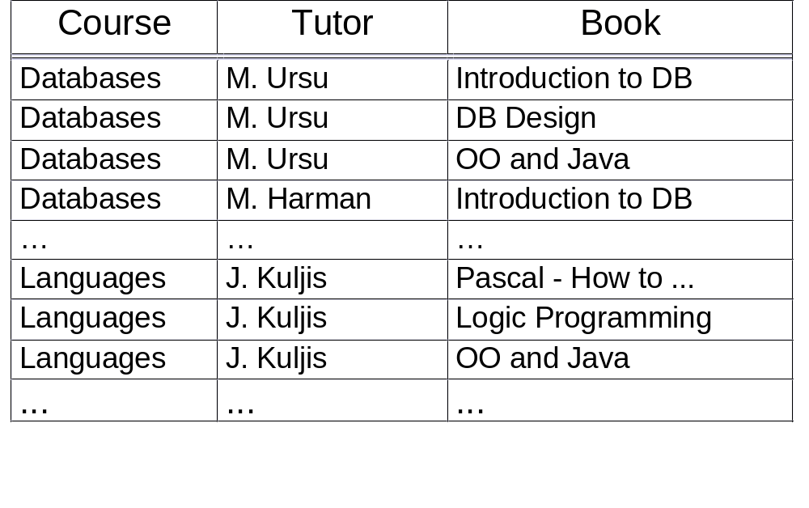
1N relation

Slide 90
Note
IF (c1, t1, b1) and (c1, t2, b2) exist
as tuples in the relation
THEN (c1, t1, b2) and (c1, t2, b1)
also exist in the relation

Slide 91
Question
what normal forms is this relation in?
helping question
  what functional dependencies can you identify?
Notes:
ANSWERS
1. The relation is in BCNF
2. There are no functional dependencies
3. if a relation is in a normal form defined based on FD it does not mean that it is a good representation of reality; even though in BCNF it still presents a great deal of redundancies and also update anomalies ...

Slide 92
Shortcomings
redundancy
therefore: update anomalies
      e.g. add a new tutor, C. Fox, for the Databases course: both tuples, (Databases, C. Fox, Introduction to DB) and (Databases, C. Fox, DB Design), have to be added
      could you think of a better solution?
this is a “problem” BCNF relation
what do you conclude about the studied normal forms?

Slide 93
Common-sense solution
separate independent repeating groups
  decompose the un-normalised relation
  bring it to 1NF
  the solution:
    shortcomings - removed
    non-loss decomposition

Slide 94
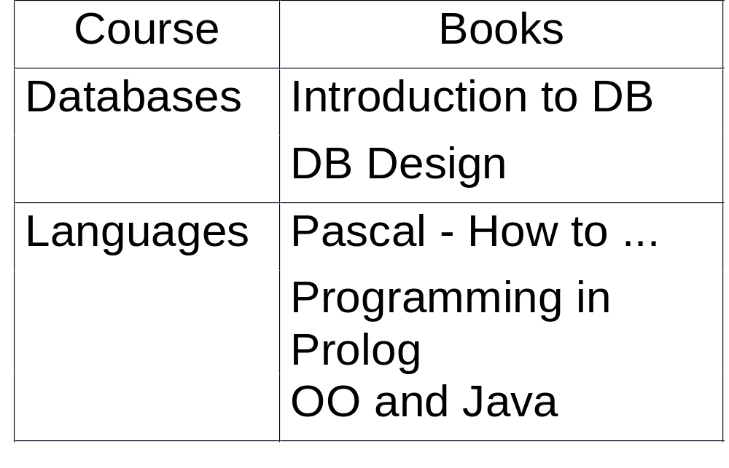

Decompose the un-normalised relation

Slide 95
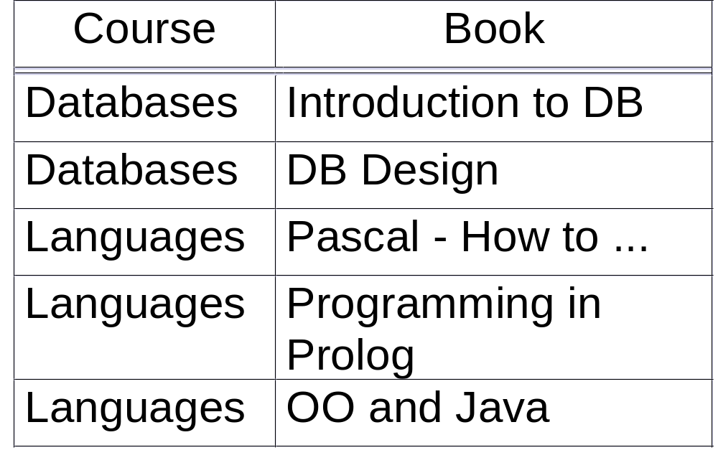

Bring to 1NF

Slide 96
Another example
［EXAMPLE］WSC（W，S，C）
    W表示仓库，S表示保管员，C表示商品
    假设每个仓库有若干个保管员，有若干种商品
    每个保管员保管所在的仓库的所有商品
    每种商品被所有保管员保管
An Introduction to Database System

Slide 97
CON…
W | S | C
W1 | S1 | C1
W1 | S1 | C2
W1 | S1 | C3
W1 | S2 | C1
W1 | S2 | C2
W1 | S2 | C3
W2 | S3 | C4
W2 | S3 | C5
W2 | S4 | C4
W2 | S4 | C5
An Introduction to Database System

Slide 98

CON…
W→→S且W→→C
An Introduction to Database System

Slide 99
Trivial MVDs
R, is a relation; X and Y arbitrary sets of attributes of R
X Y is trivial if and only if
  Y ⊆ X or
  X ∪ Y = R
a trivial MVD does not represent a constraint

Slide 100
Questions
is every FD a MVD?
is every MVD a FD?

Slide 101
Towards 4NF
MVDs are a generalisation of FDs
the existence of non-trivial MVDs that are not FDs causes problems
AIM: to eliminate such situations

Slide 102
4NF
R is in 4NF if and only if any MVD is either
  trivial, or
  it is also a FD
4NF is always achievable

